Slide 1

Coexist?
Coexist
Science & Religion
Science & Religion

Slide 2

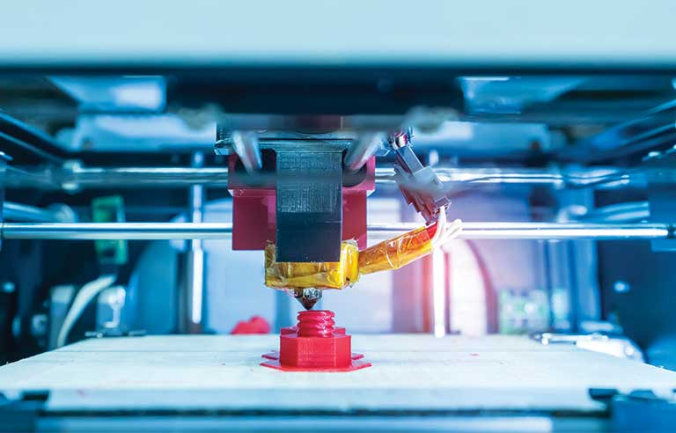


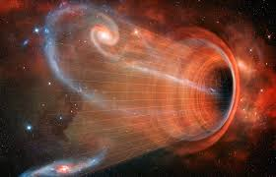

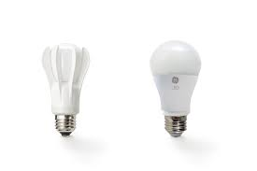


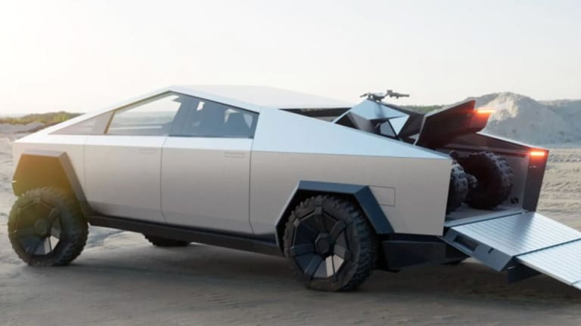

Slide 3
Question: “How does religious affiliation impact one’s likelihood of supporting further efforts in science research by the federal government”?

Slide 4
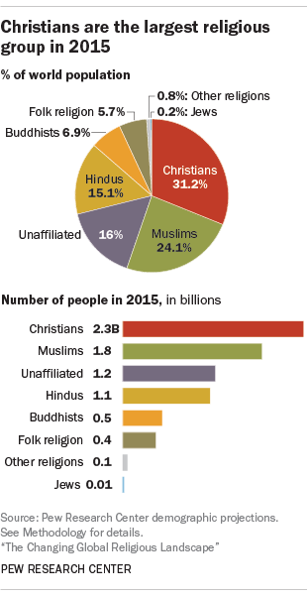
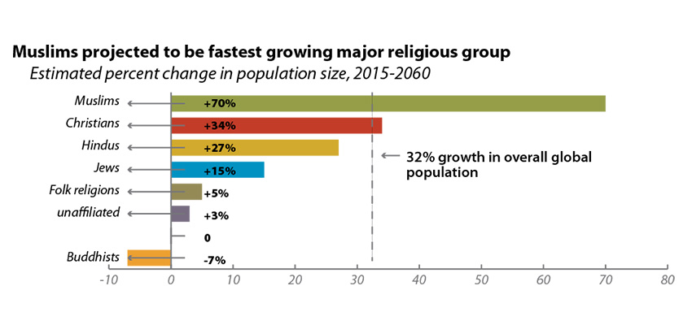
Religion Worldwide:
Currently, 6.2 billion individuals claim that they are religious
By 2060, the, world’s population is expected to increase by 32% from 7.3 billion to 9.6 billion
During this time, the number of Muslims, currently the religious group with the youngest and most fertile population, is expected to increase by 70%
The number of Christians worldwide is expected to increase by 34%
The number of Hindus is expected to rise by 27%

Slide 5
Religion Among Scientists Worldwide
In Italy, India, Turkey, and Taiwan over 50% of scientists claim to be at least “slightly religious”
In India, it is 94% while in France it is 30%
Almost 10% of scientists in the US and UK have “no doubt” that there is a God compared to 15% of scientists in India and 66% of scientists in Turkey
According to a study published in 2016 conflict between science and religion is more pronounced in Western regions

Slide 6
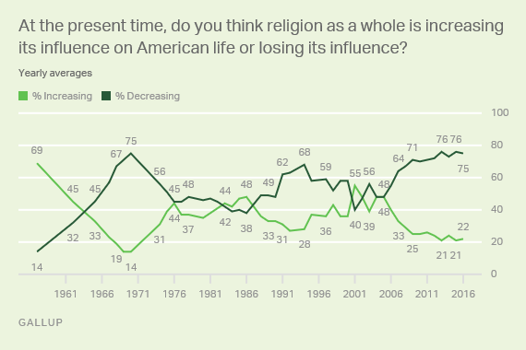
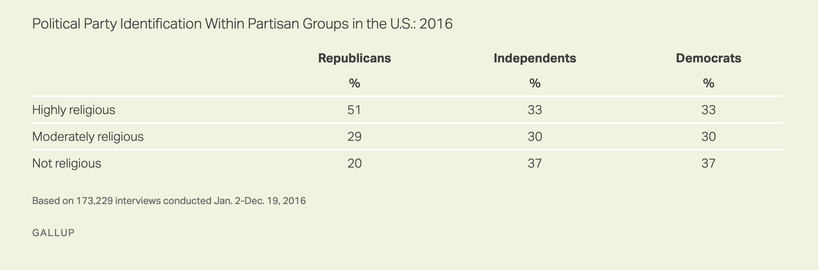
Religion in the U.S.
Nearly 8 in 10 Americans identify with a religion
74% Christian, 5% non-christian religions
People reporting no religious identity has gone from 15% to 21% from 2008 and over 7 in 10 Americans believe religion is losing its influence in U.S.
The most significant trend in Americans' religiosity in recent decades has been the growing shift away from formal or official religion. This represents a major change from the late 1940s and 1950s when only 2% to 3% of Americans did not report a formal religious identity that in the 1970s. The percentage crossed the 10% threshold in 1990 and has continued climbing since.

Slide 7
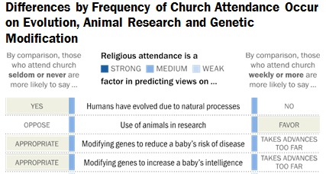
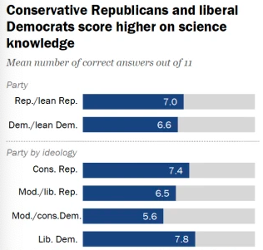
Scientific Consensus in the U.S.
Among the American public, a lot of science is generally accepted and trusted. However, topics like stem cell research, the big bang, evolution and climate change have become deeply polarizing. Individuals with more science education and science literacy have been shown to have more polarized beliefs on these issues

Slide 8
Methods
In order to test our hypothesis we used a data set from the General Social Surveys where respondents were asked a myriad of questions over a broad range of issues, including age, gender, social network, political participation, religion, worklife, and more.
The median length of the interview is about one and a half hours.
Our Variables included
religion, annual income, highest degree achieved, race, gender, political views score, a scientific knowledge score, and support for federal funding of scientific research

Slide 9
REGRESSION MODEL for ADVFRONT
tgss$ADVFRONT =
-0.0099289tgss$RELIG+
0.0705509tgss$POLVIEWS +
-0.0026378tgss$INCOME +
0.0391983tgss$SEX +
-0.0687765 tgss$DEGREE +
0.0008950tgss$AGE +
-0.0018400tgss$RACE +
1.6314283
Coefficients | Estimate | Std. Error | T Value | Pr(>|t|)
(Intercept) | 1.6314283 | 0.0621800 | 26.237 | < 2e-16 ***
tgss$RELIG | -0.0099289 | 0.0035120 | -2.827 | 0.00471 **
tgss$POLVIEWS | 0.0705509 | 0.0053183 | 13.266 | < 2e-16 ***
tgss$INCOME | -0.0026378 | 0.0037052 | -0.712 | 0.47654
tgss$SEX | 0.0391983 | 0.0150664 | 2.602 | 0.00930 **
tgss$DEGREE | -0.0687765 | 0.0064555 | -10.654 | < 2e-16 ***
tgss$AGE | 0.0008950 | 0.0004588 | 1.951 | 0.05113 .
tgss$RACE | -0.0018400 | 0.0116616 | -0.158 | 0.87463
Signif. codes: 0 ‘***’ 0.001 ‘**’ 0.01 ‘*’ 0.05 ‘.’ 0.1 ‘ ’ 1 ----------------------------------------------------------------------------------------------------------------- Residual standard error: 0.6324 on 7290 degrees of freedom (57516 observations deleted due to missingness) Multiple R-squared: 0.04763, Adjusted R-squared: 0.04672 F-statistic: 52.09 on 7 and 7290 DF, p-value: < 2.2e-16

Slide 10
REGRESSION MODEL for SCI KNOWLEDGE
tgss$sciknowledge =
-0.0034201tgss$RELIG + 0.0135063tgss$POLVIEWS + 0.0056008tgss$INCOME + -0.0142288tgss$SEX + 0.0022116tgss$DEGREE + 0.0004915tgss$AGE + 0.0051803tgss$RACE
Coefficients | Estimate | Std. Error | T Value | Pr(>|t|)
(Intercept) | 1.3110795 | 0.0241992 | 54.179 | < 2e-16 ***
tgss$RELIG | -0.0034201 | 0.0013546 | -2.525 | 0.01164 *
tgss$POLVIEWS | 0.0135063 | 0.0020020 | 6.746 | 1.88e-11 ***
tgss$INCOME | 0.0056008 | 0.0014462 | 3.873 | 0.00011 ***
tgss$SEX | -0.0142288 | 0.0059420 | -2.395 | 0.01671 *
tgss$DEGREE | 0.0022116 | 0.0024713 | 0.895 | 0.37093
tgss$AGE | 0.0004915 | 0.0001946 | 2.526 | 0.01161 *
tgss$RACE | -0.0051803 | 0.0046911 | -1.104 | 0.26957
Signif. codes: 0 ‘***’ 0.001 ‘**’ 0.01 ‘*’ 0.05 ‘.’ 0.1 ‘ ’ 1 ----------------------------------------------------------------------------------------------------------------- Residual standard error: 0.146 on 2467 degrees of freedom (62339 observations deleted due to missingness) Multiple R-squared: 0.04209, Adjusted R-squared: 0.03937 F-statistic: 15.49 on 7 and 2467 DF, p-value: < 2.2e-16

Slide 11

Questions?

